Slide 1
Website for the Heavy Machinery Industry
Course: CS 390
Team #: 6
Team Members: Brad, Tyler

Slide 2
Customer Requirements:
System’s Need and Feasibility
Why does somebody need this system?
Websites allow customers, employees, and investors to interact with the company and gain information in ways that are impossible offline
View, sort, and compare all of the company’s products in one place
Request quotes or further information with no hassle
Stay up to date on all news published about the company
What are the advantages of our new system?
Our system offers two new functions not found on any of the competitors websites
Price comparison against competing products
Details about current projects involving our company

Slide 3

Customer Requirements:
System’s Scope
Primary users are those involved in other companies that are planning construction projects
Estimated 500,000 users per month
Globally available to anyone with access to the Internet
itpro.co.uk/611782/blade-networks-industry-ready-for-10gb-ethernet

Slide 4
Customer Requirements:
Functionality
Login & Logout
Registration (Customers & Employees)
View Parts & Equipment
Compare Parts & Equipment
Order Parts & Equipment
View Competitor Prices
Calculate Price Differences
Search Website
Contact Employees
Find a Dealer or Distributor
View Current Job Openings
Apply for Jobs
View Media
Add / Remove Projects
Share to Social Media
Main Functions:

Slide 5
Customer Requirements:
Technical Platform & Environment
Access to the Internet is REQUIRED to use this system
Supported Platforms:
Windows PC (Windows 7, Windows 8, Windows 8.1, Windows 10 or later)
Most recent version of Google Chrome, Firefox, or Microsoft Edge
Mac (OS X Yosemite 10.10 or later)
Most recent version of Safari, Opera, Google Chrome, or Firefox
Linux (64-bit Ubuntu 14.04+ or equivalent)
Most recent version of Google Chrome, Chromium, Opera, or Firefox

Slide 6
Customer Requirements:
Possible Main Constraints
Technology
The system must conform to current standard computer and Internet protocols
Cost
Total Cost of System: $377,000
Employee Salaries
Database Initial and Monthly Fees
Equipment Costs
Time
The system must be fully completed, tested, and optimized within 18 months of initiation to remain relevant
People
The system requires knowledgeable employees to be built and maintained

Slide 7
Customer Requirements:
Similar Websites
http://www.caterpillar.com/
https://www.komatsuamerica.com/
https://www.volvoce.com/
https://www.hitachicm.com/
https://www.liebherr.com/en/deu/start/start-page.html
http://www.sanyglobal.com/
https://www.terex.com/
http://www.doosaninfracore.com/en/
https://www.deere.com/en/

Slide 8
Analysis Phase:
Heavy Machinery Company Websites
Caterpillar
Komatsu
Volvo Construction Equipment
Hitachi Construction Equipment
Liebherr
Sany
Zoomlion
Terex
Doosan Infracore
John Deere
Source: https://constructionreviewonline.com/2017/04/topconstruction-equipment-manufacturers/

Slide 9
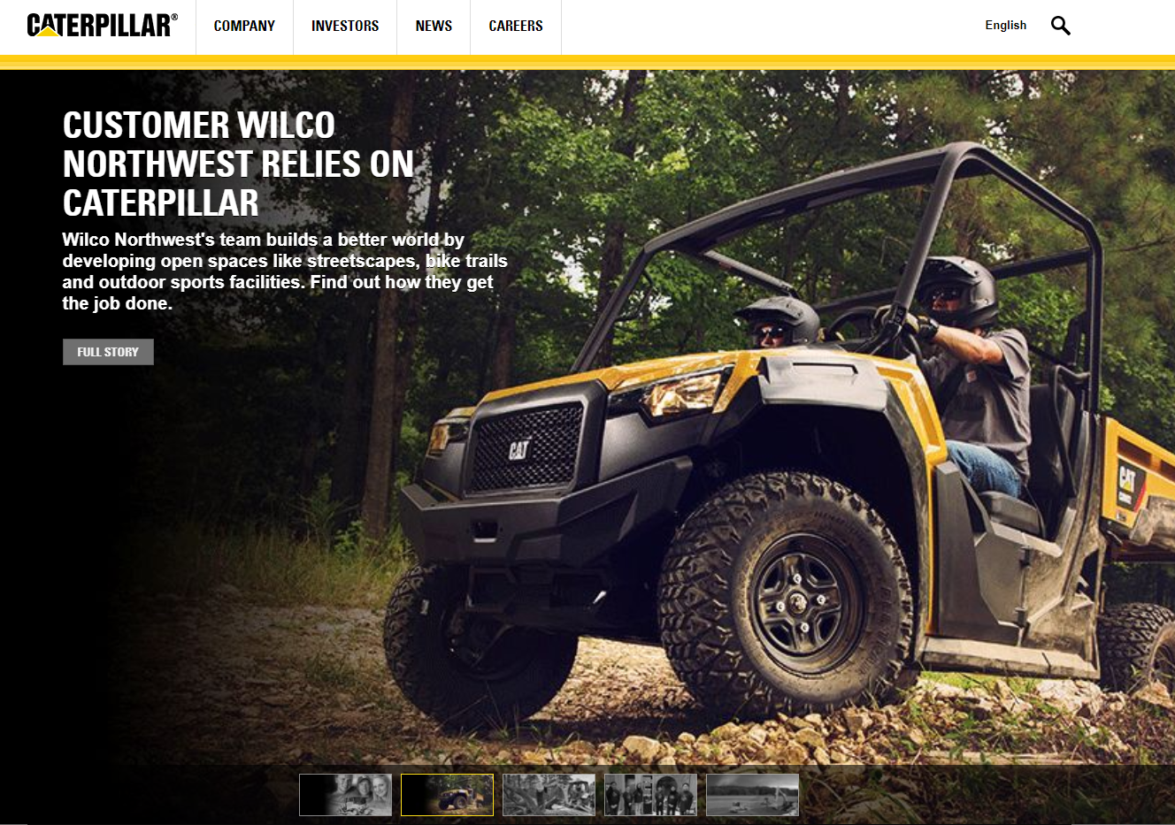
Main Identified 20 Class Objects:
Customers
Equipment
Company
Investors
Employees
Dealers
Departments
Careers
News
Search box
Contacts
Site map
Projects
Finances
Images
System Admin
Stock Info
Social media
Locations
Database
Main Identified 20 Functions:
Search website
View equipment specifications
Compare equipment
Contact dealers
Search locations
Search & apply
Schedule visits
View news updates
Purchase stocks
Get email alerts
Contact shareholder services
View financial information
Request materials
Share to social media
Search for parts
Listen to webcast
Read jobsite stories
Get support
Visit forums
Change search location
#1: Caterpillar
Source: https://www.caterpillar.com/

Slide 10
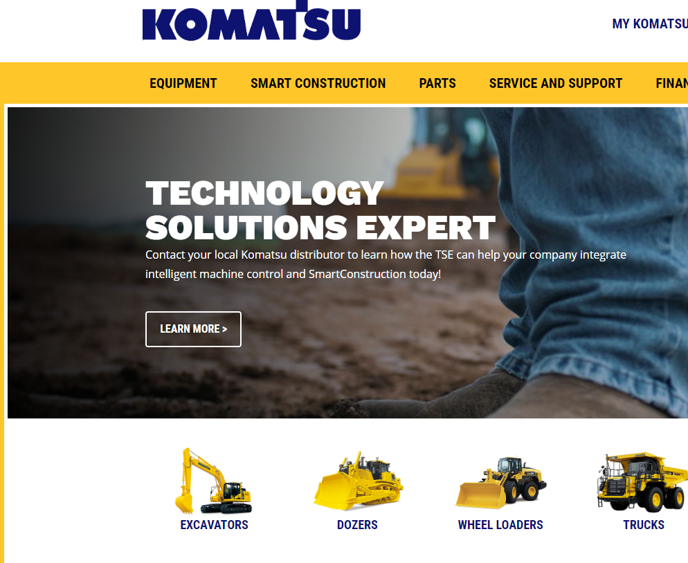
Main Identified 20 Class Objects:
Customers
Equipment
Company
Employees
System Admin
Parts
Service and support
Financing
Recent blogs
My Komatsu
Search box
Careers
Contacts
News and press
Images
Locations
Site map
Social media
Videos
Database
Main Identified 20 Functions:
Search website
Search locations
Search equipment
View menu
Locate a distributor
Compare equipment
Request a quote
Manage your account
View customer stories
View press releases
Search jobs
Search for parts
Order parts
Schedule visit
Watch videos
Apply for lease
Renew lease
Convert to purchase
Return equipment
Share to social media
#2: Komatsu
Source: https://www.komatsuamerica.com/

Slide 11
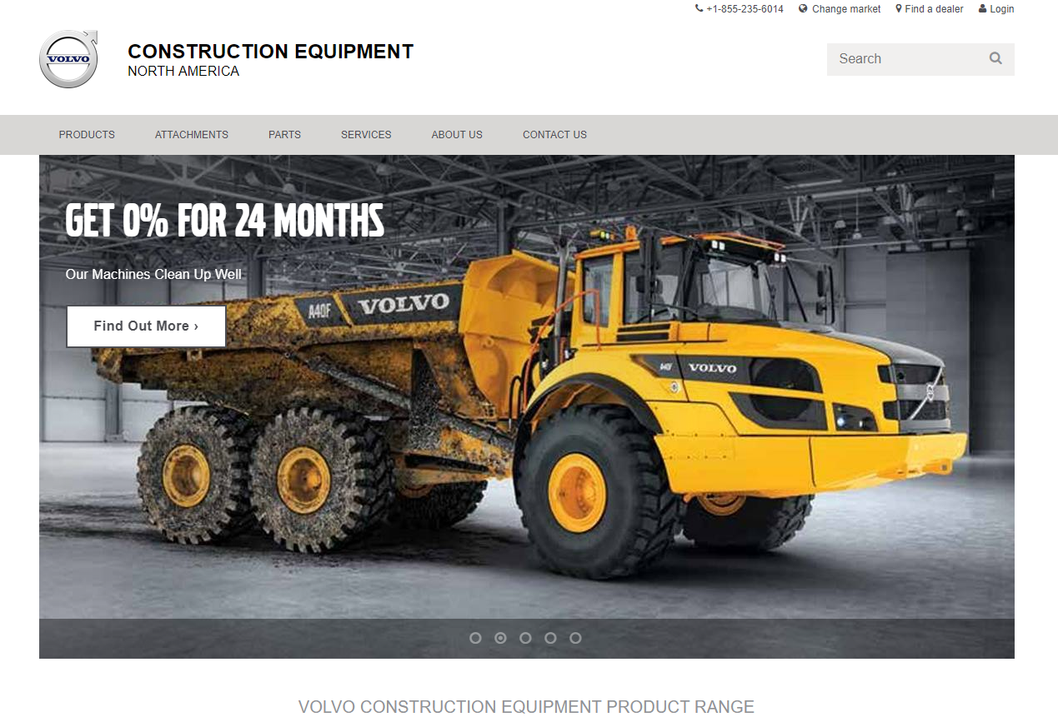
Main Identified 20 Class Objects:
Customers
Equipment
Company
Employees
Attachments
Parts
Services
About us
Contacts
News
Social media
Careers
Search box
Site map
Locations
Videos
Images
System Admin
Events
Database
Main Identified 20 Functions:
Search website
Change market
Find a dealer
Login
Request machine information
Download brochures
Contact us
Search attachments
Order attachments
Make a request
Logout
Refine news stories
View news stories
View customer stories
Apply now
Register Customers
Register for events
Watch videos
View images
Share to social media
#3: Volvo Construction Equipment
Source: https://www.volvoce.com/united-states/en-us/

Slide 12
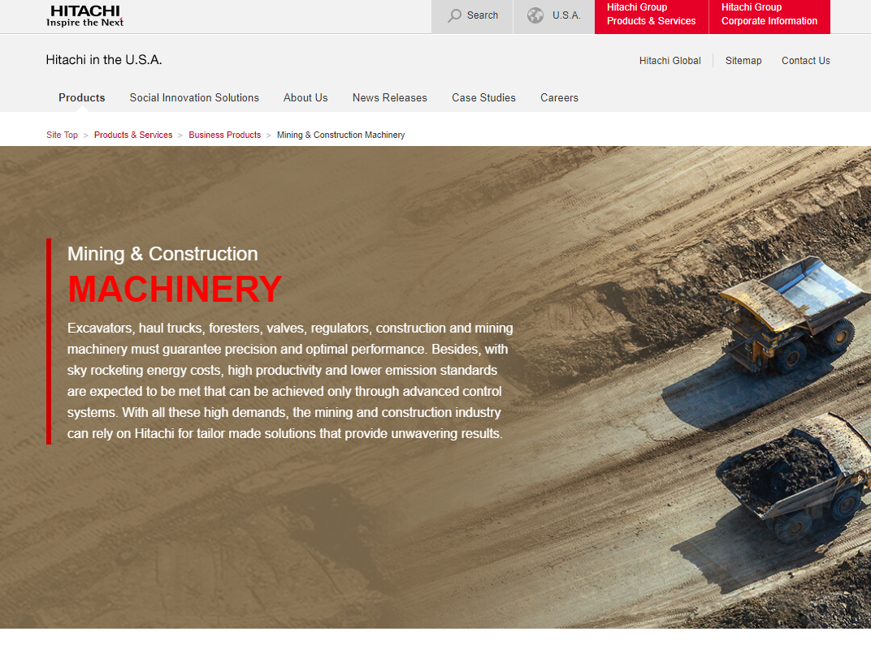
Main Identified 20 Class Objects:
Customers
Equipment
Company
Employees
Sitemap
Search box
Contacts
Mining
Construction Machinery
Case studies
Careers
News
Social Media
Videos
Directory
Government Relations
Images
Products
Database
System administrator
Main Identified 20 Functions:
Search website
Change location
Choose language
Contact us
Locate a dealer
View product information
Compare equipment
Download brochures
Purchase products
View company job directory
Apply for jobs
Watch event live streams
View news stories
View case studies
Send inquiry forms
Login
Logout
View images
Read government policies
Share to social media
#4: Hitachi Construction Equipment
Source: http://www.hitachi.us/

Slide 13
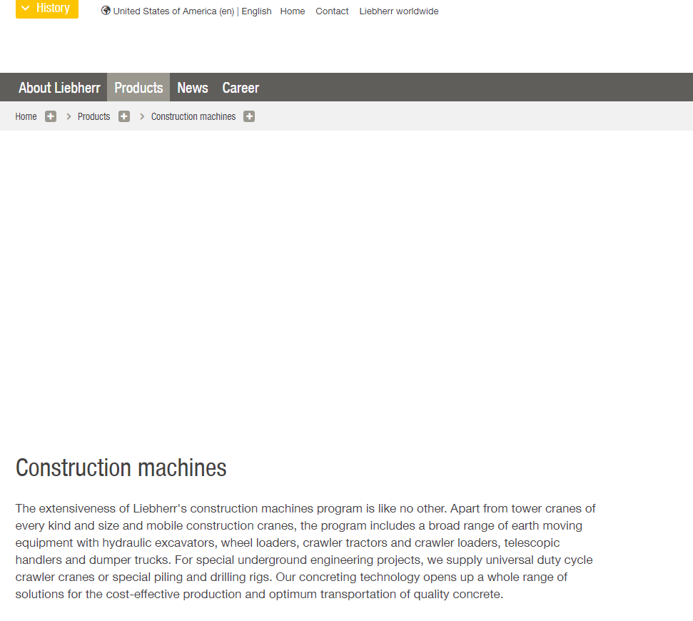
Main Identified 20 Class Objects:
Database
System Administrator
Customers
Equipment
Company
Employees
Products
Careers
News
Social Media
Contacts
History
Site Map
Locations
Departments
Search Box
Annual reports
Services
Shop
Images
Main Identified 20 Functions:
Print Page
Go To Top of Page
Change Location
Choose Language
Add Equipment
Remove Equipment
Compare Equipment
View Product Information
Download Brochures
Rent Machine
Find Used Machines
Register Customers
Login
Logout
Watch Videos
Find Contact Persons
Search Company Jobs Directory
Apply For Jobs
Request Services
Share To Social Media
#5: Liebherr
Source: https://www.liebherr.com/en/usa/products/construction-machines/construction-machines.html

Slide 14

Main Identified 20 Class Objects:
Database
System Administrator
Customers
Equipment
Company
Employees
Products
News
Support
Service
Contacts
Inquiry
Financing
Training
Service Network
Technologies
Images
Search box
Site Map
Locations
Main Identified 20 Functions:
Search website
Change location
Choose language
Contact us
View product information
Add equipment
Remove equipment
Compare equipment
Download brochures
Send equipment inquiry
Request quote
View news stories
View customer stories
View construction cases
Send inquiry forms
Login
Logout
View images
Watch videos
Share to social media
#6: Sany
Source: https://www.sanyglobal.com/

Slide 15
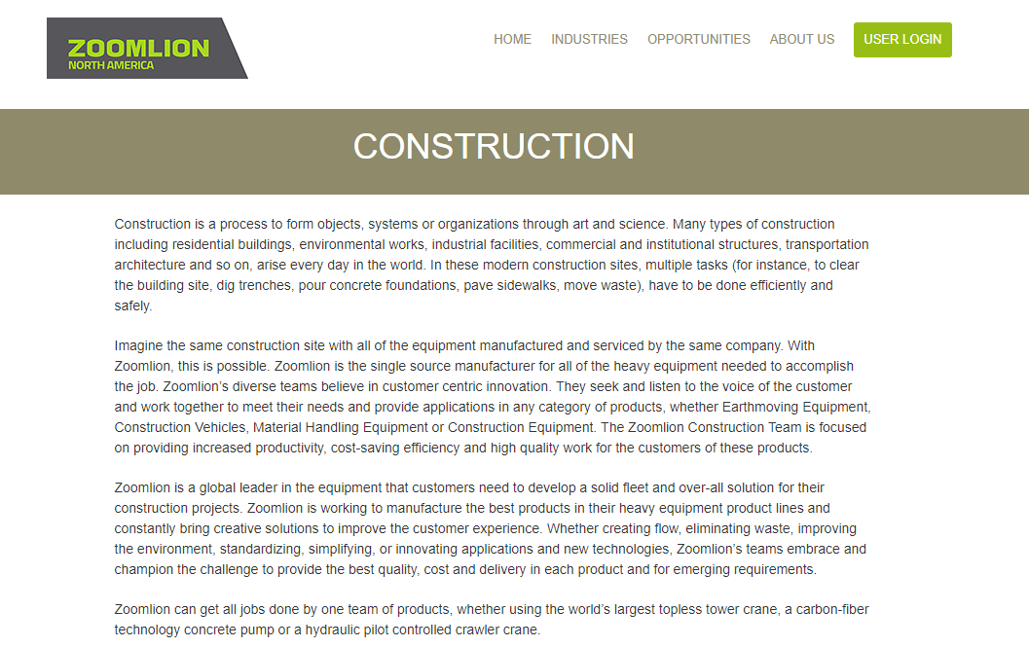
Main Identified 20 Class Objects:
Database
System Administrator
Customers
Equipment
Company
Employees
Industries
Opportunities
Careers
Contacts
Benefits
History
Agriculture
Finance
Construction
Transportation
Municipal
Testimonials
Address
Images
Main Identified 20 Functions:
Login
Logout
Register Customers
Remove Customers
Register Employees
Remove Employees
Apply for Jobs
View Current Job Openings
Contact Company Departments
Edit Pages
Display Pages
View Pages
Add Images
Display Images
View Images
Download Images
Add Phone Numbers
Edit Phone Numbers
Add Addresses
Edit Addresses
#7: Zoomlion
Source: https://zoomlion-na.com/

Slide 16
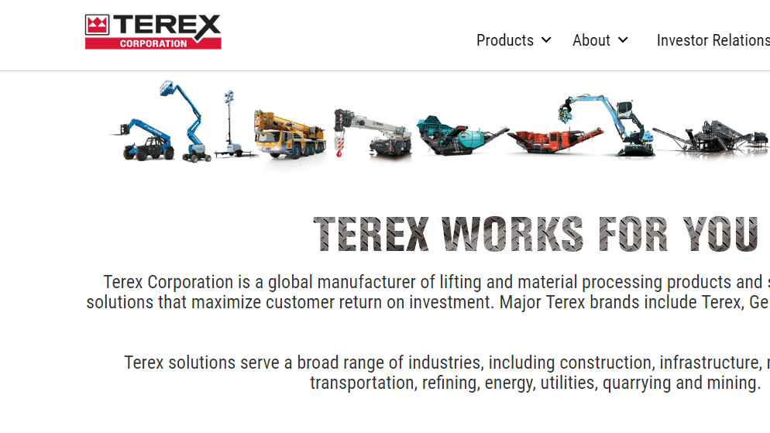
Main Identified 20 Class Objects:
Database
System Administrator
Customers
Equipment
Company
Employees
Images
Search Box
Locations
Investors
Careers
Parts
Contacts
Social Media
Sitemap
Cranes
Utilities
Port Solutions
News
Suppliers
Main Identified 20 Functions:
Login
Logout
Choose Language
Register Customer
Register Employees
Search Website
Add Equipment
Remove Equipment
Get a Quote
Search for Parts
Order Parts
Find a Dealer
Download Brochures
Request Special Equipment
Search Used Equipment Inventory
Request Tech Support
Request Financial Services
View News Stories
Search Positions by Location
Share to Social Media
#8: Terex
Source: https://www.terex.com/en

Slide 17
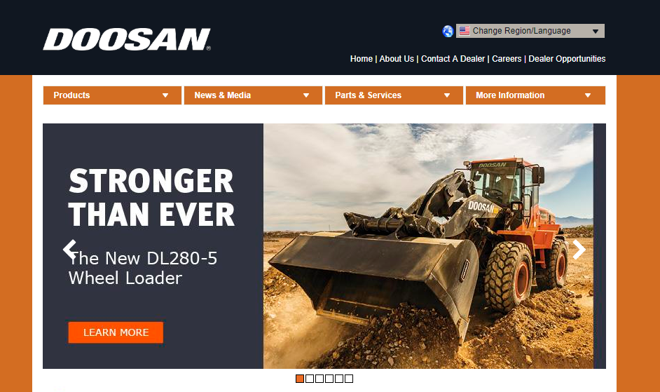
Main Identified 20 Class Objects:
Database
System Administrator
Customers
Equipment
Company
Employees
Images
Careers
Contacts
News
Parts
Sitemap
Videos
Social Media
Excavators
Handlers
Attachments
Dump Trucks
Log Loaders
Locations
Main Identified 20 Functions:
Login
Logout
Register Customers
Change Region
Choose Language
Find a Dealer
Request A Demo
Request A Brochure
Download Brochures
Email Sign Up
Request Product Info
Add Equipment
Remove Equipment
View Equipment Specifications
Print Specifications
Compare Equipment
Register Employees
Add Images
Remove Images
Share to Social Media
#9: Doosan Infracore
Source: http://www.doosanequipment.com/dice/index.page?

Slide 18
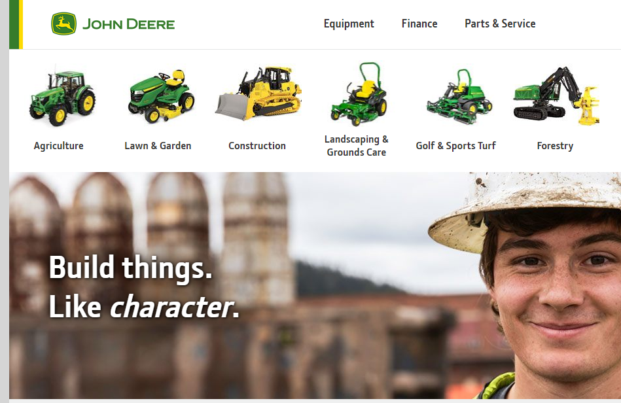
Main Identified 20 Class Objects:
Database
System Administrator
Customers
Equipment
Company
Employees
Images
Search Box
Site map
Social Media
Products
Publications
Finance
Parts
Locations
News
Investors
Agriculture
Construction
Forestry
Main Identified 20 Functions:
Login
Logout
Register Customers
Register Employees
Search Website
Buy Online
Build Your Own
Order Parts
Add Equipment
Find Manuals
Add Images
Remove Images
Search Site Map
Add News
View News
View Equipment
Add Parts
View Parts
Add Locations
Share to Social Media
#10: John Deere
Source: https://www.deere.com/en/index.html

Slide 19
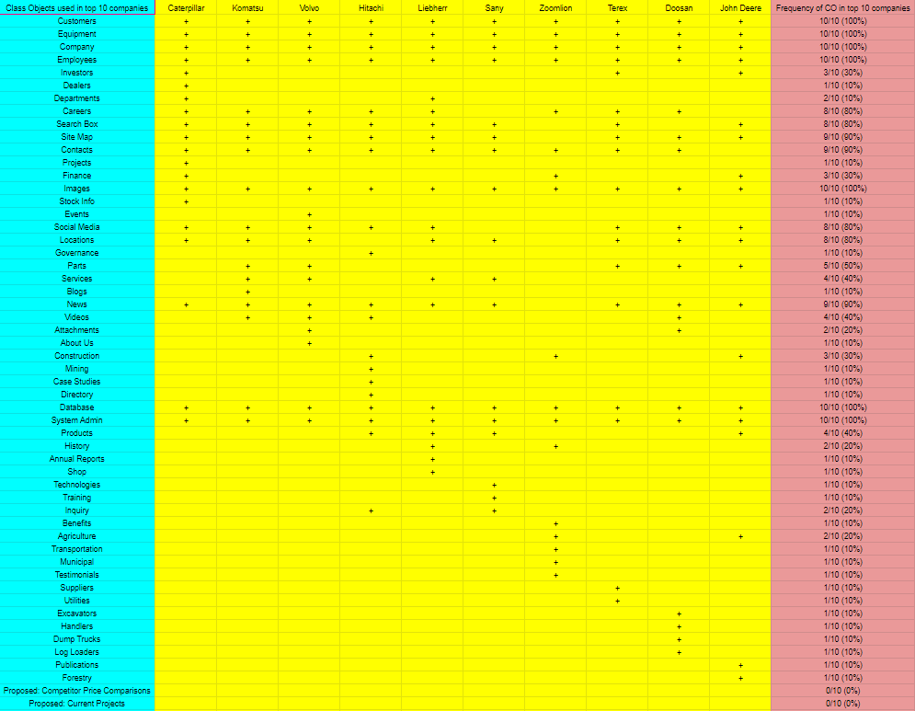
Full Analysis Phase: Identified Common COs and proposed COs

Slide 20
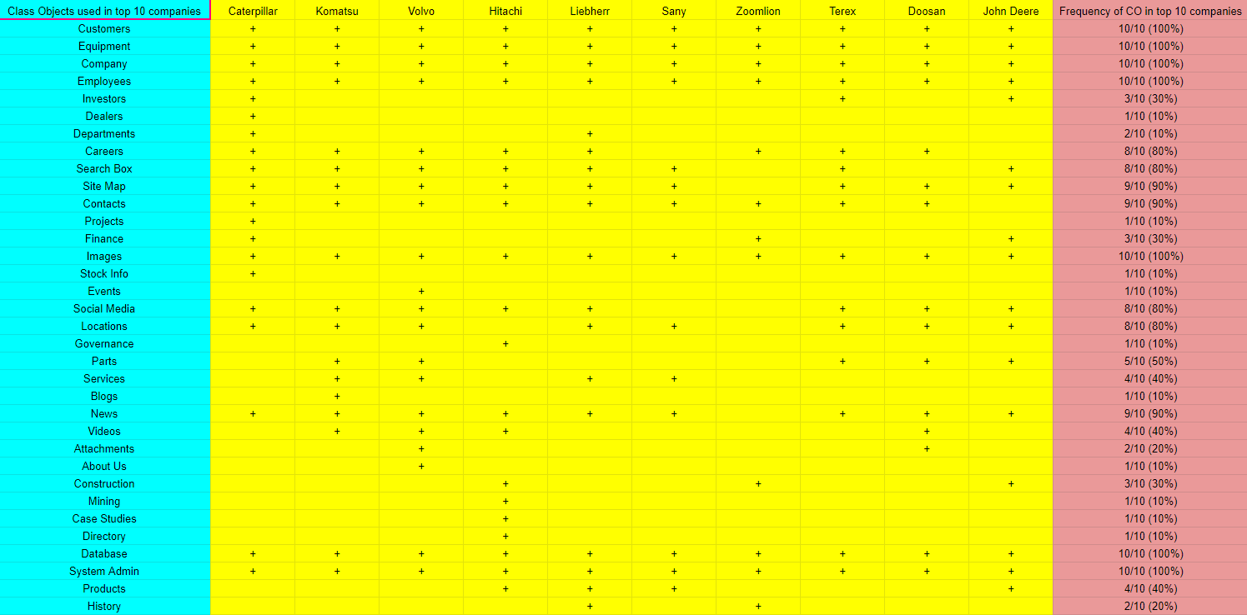
Analysis Phase: Identified Common COs and proposed COs Part 1

Slide 21
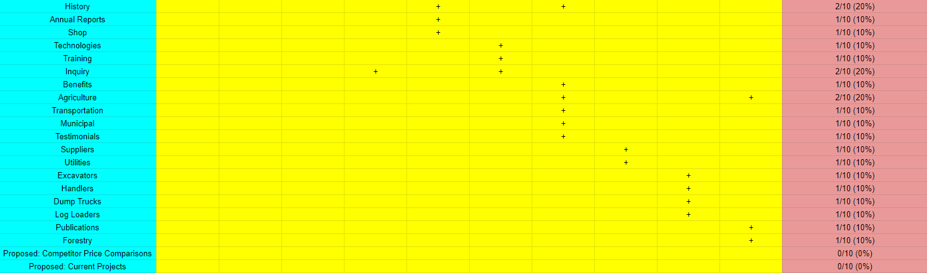
Analysis Phase: Identified Common COs and proposed COs Part 2

Slide 22
A list of COs to be included in our new system and 2 new proposed COs:
Customers
Equipment
Company
Employees
Images
Database
System Administrator
News
Site Map
Contacts
Careers
Social Media
Locations
Parts
Services
Videos
Products
Departments
Quotes
Investors
NEW Proposed CO: Competitor Prices
NEW Proposed CO: Current Projects

Slide 23
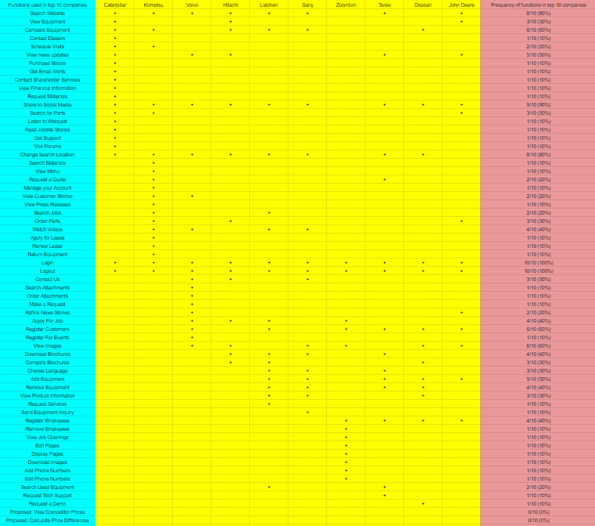
Full Analysis Phase: Identified Common Functions and Proposed Functions

Slide 24
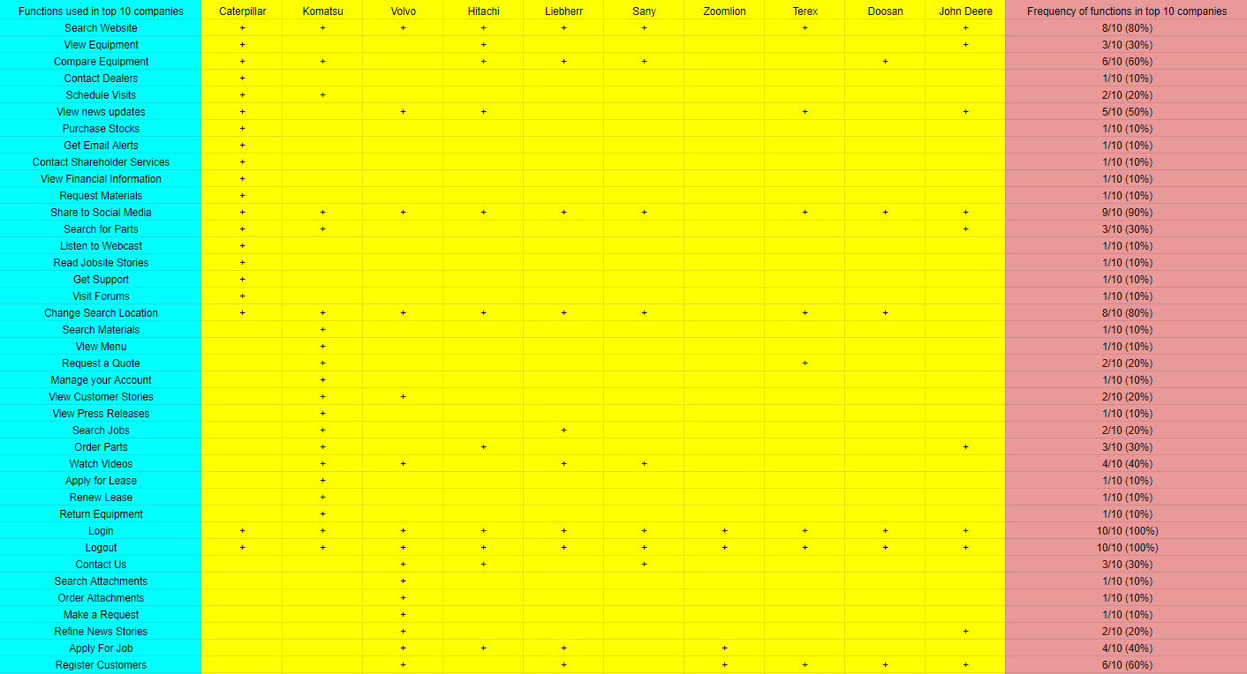
Analysis Phase: Identified Common Functions and Proposed Functions Part 1

Slide 25
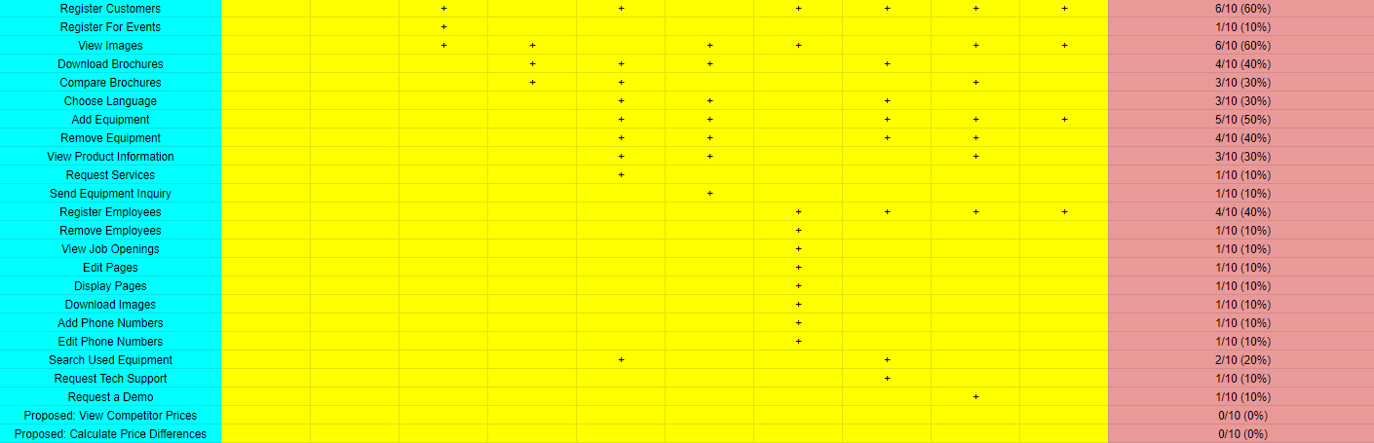
Analysis Phase: Identified Common Functions and Proposed Functions Part 2

Slide 26
A list of Functions to be included in our new system including 5 new proposed Functions:
Login
Logout
Share to Social Media
Search Website
Change Search Location
Compare Equipment
Remove Employees
View Images
View News Update
Watch Videos
Apply For Job
Add Equipment
Remove Equipment
Register Employees
Register Customers
Remove Customers
View Equipment
Order Parts
Contact Employees
Choose Language
NEW Proposed Function: View Competitor Prices
NEW Proposed Function: Calculate Price Differences
NEW Proposed Function: View Current Projects
NEW Proposed Function: Add Project
NEW Proposed Function: Remove Project

Slide 27
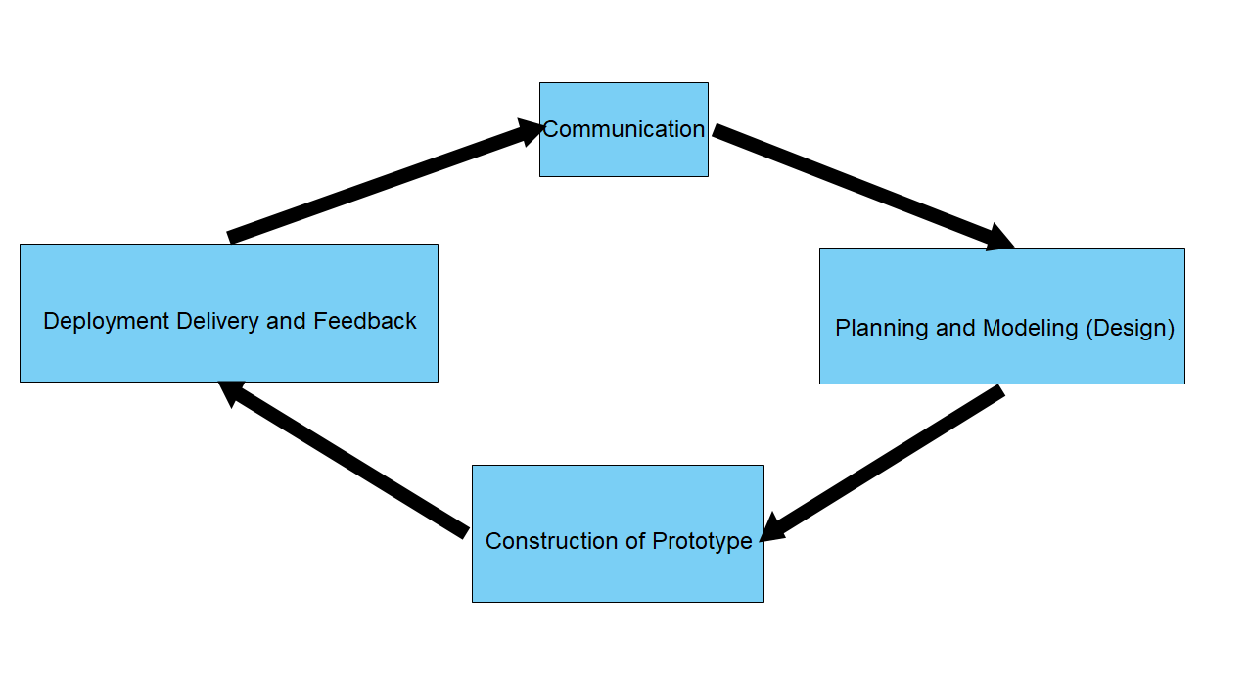
Software Engineering Process Model
Evolutionary Prototyping
Need user input for each refinement
This model reduces time and costs
Tool Used: Visual Paradigm

Slide 28
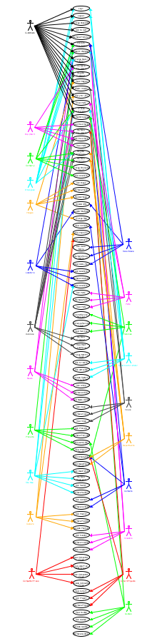
Full Use Case Diagram
Tool Used: UMLet

Slide 29
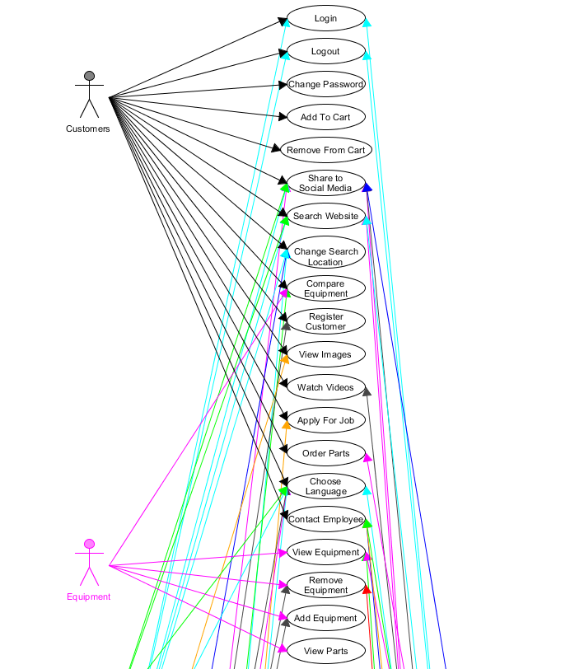
Use Case Diagram (1/4)

Slide 30
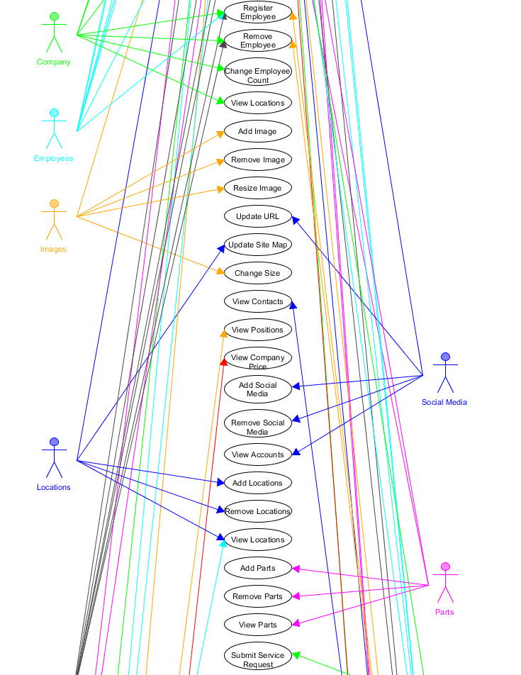
Use Case Diagram (2/4)

Slide 31
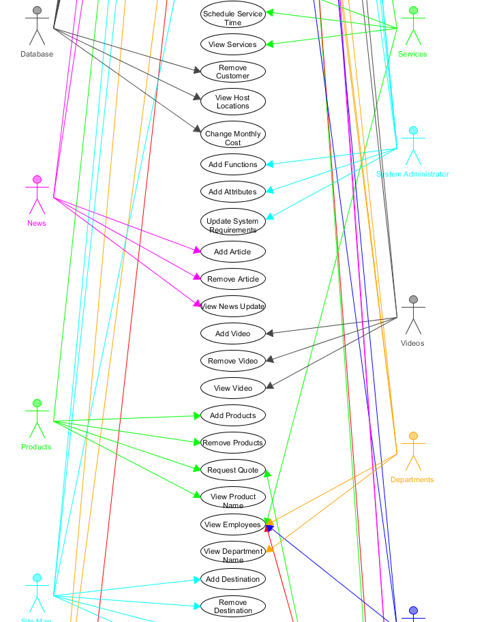
Use Case Diagram (3/4)

Slide 32
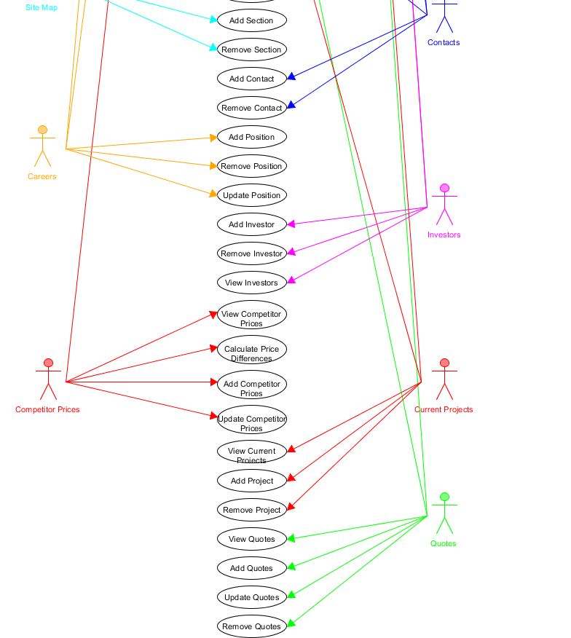
Use Case Diagram (4/4)

Slide 33
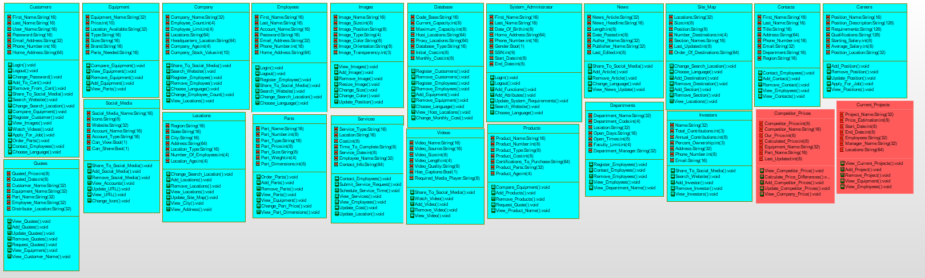
Full Class Object Diagram
Tool Used: IBM Rational

Slide 34
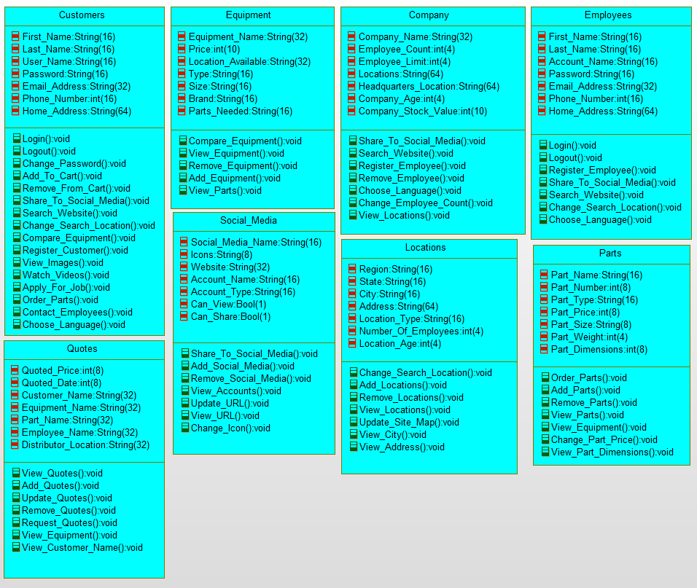
Class Object Diagram (1/3)

Slide 35
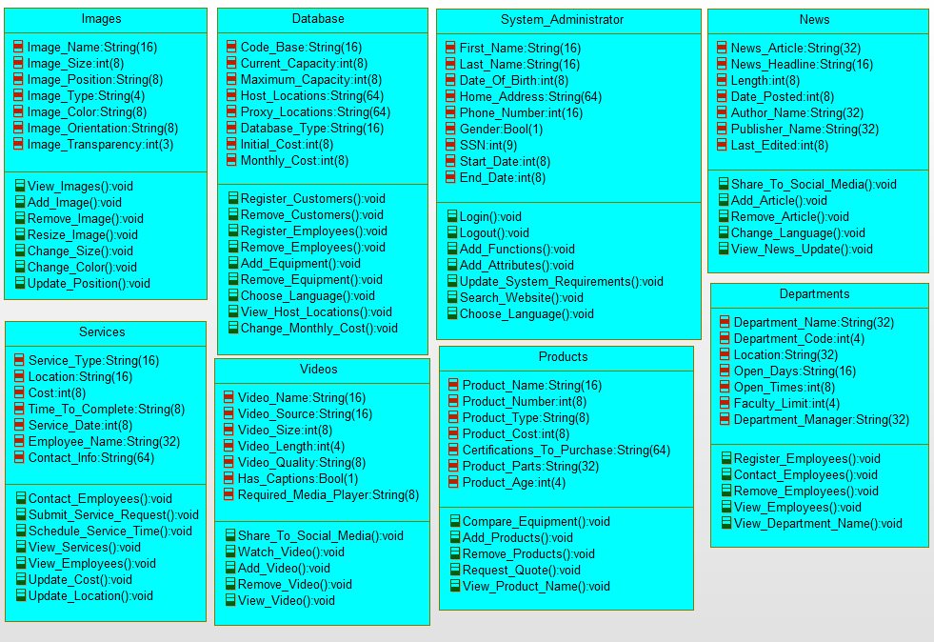
Class Object Diagram (2/3)

Slide 36
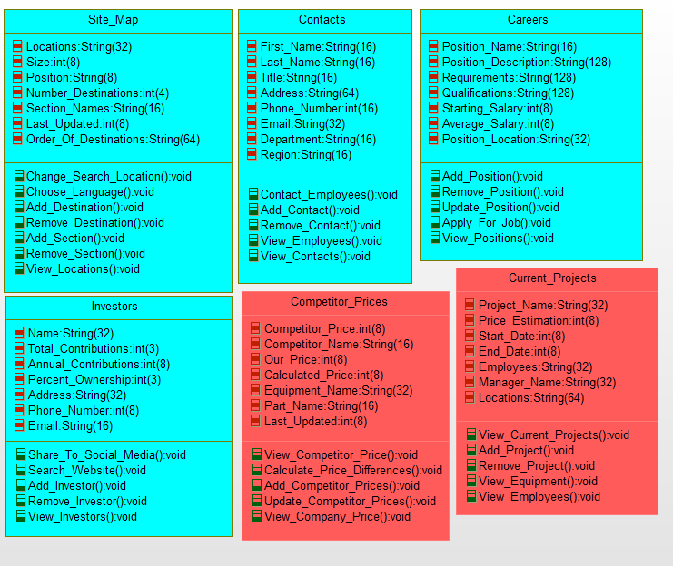
Class Object Diagram (3/3)

Slide 37
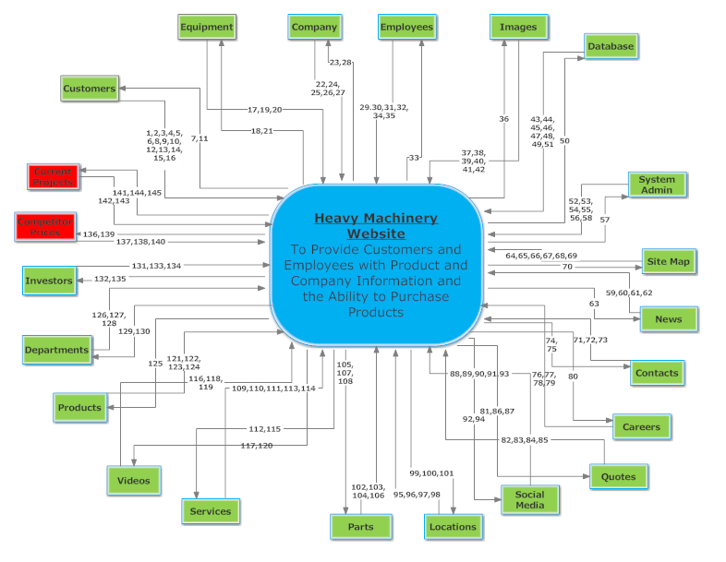
Full Context Data Flow Diagram
Tool Used: SmartDraw

Slide 38
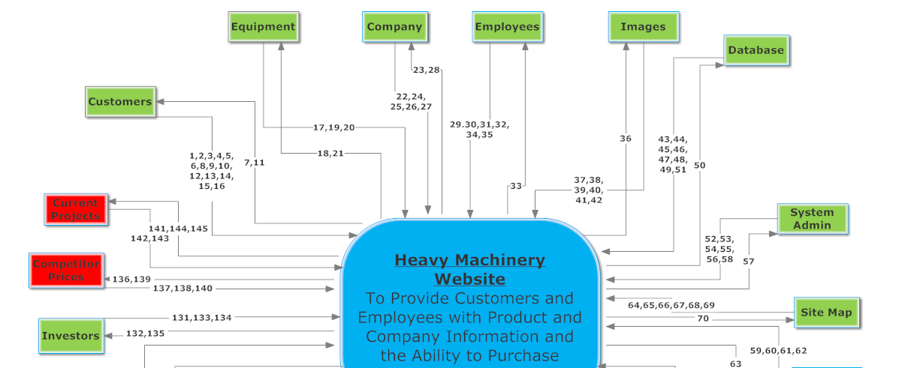
Context Data Flow Diagram (1/2)

Slide 39
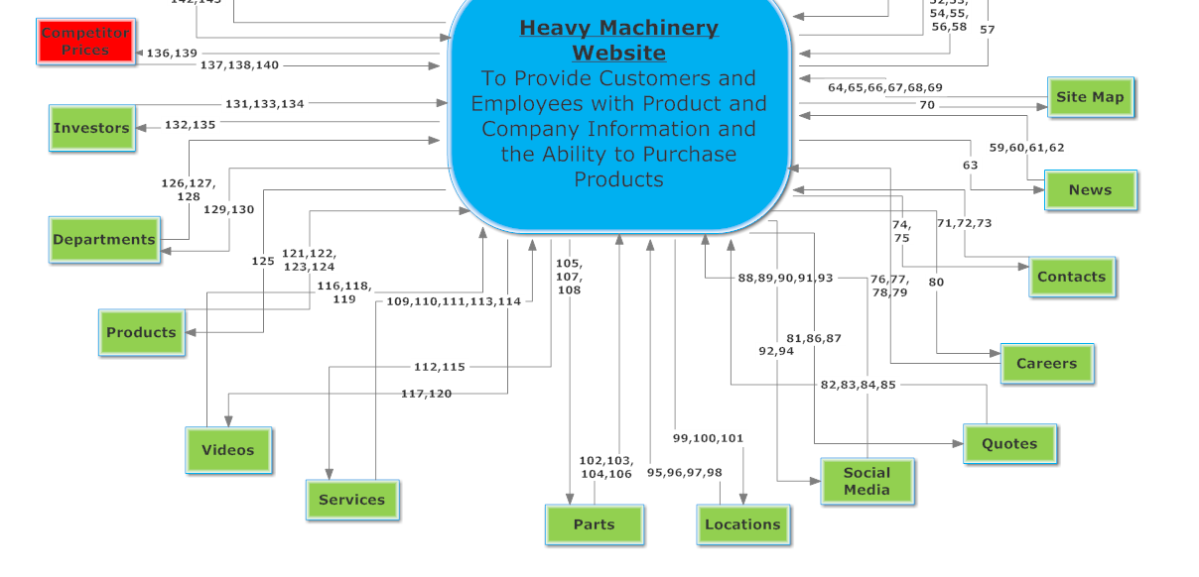
Context Data Flow Diagram (2/2)

Slide 40
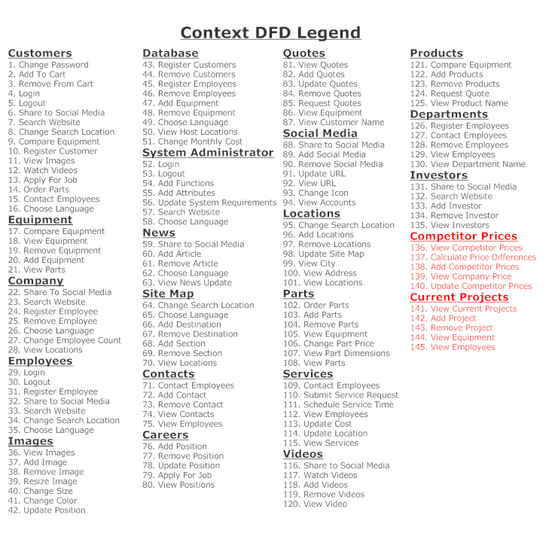
Context Data Flow Diagram Legend

Slide 41
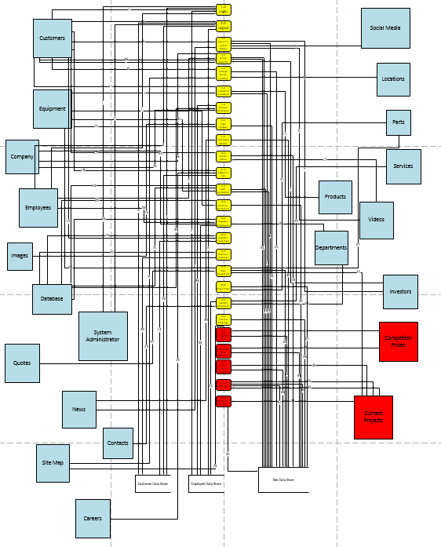
Full Level-0 Data Flow Diagram
Tool Used: MS Visio

Slide 42
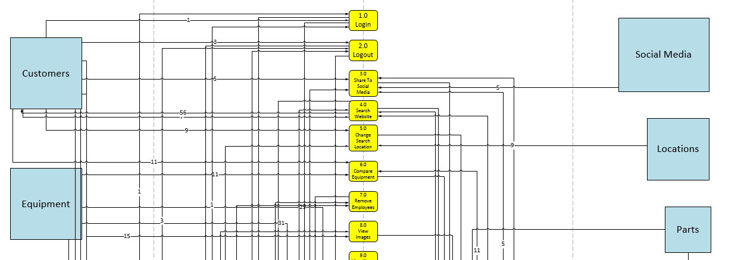
Level-0 Data Flow Diagram (1/4)

Slide 43
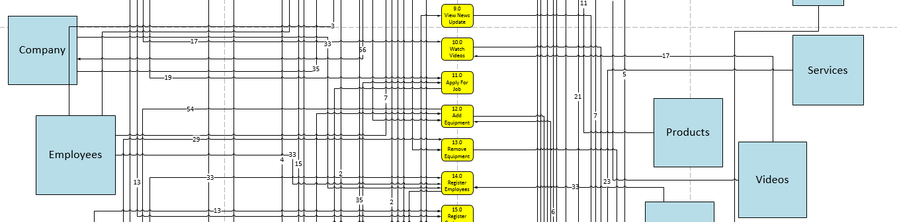
Level-0 Data Flow Diagram (2/4)

Slide 44
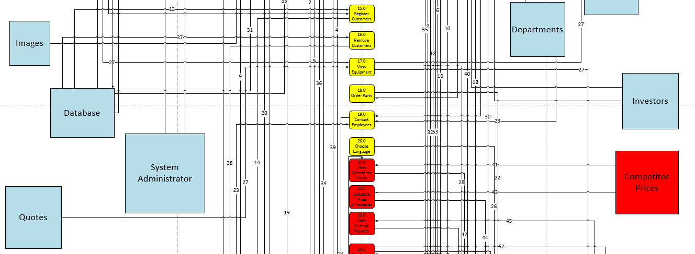
Level-0 Data Flow Diagram (3/4)

Slide 45
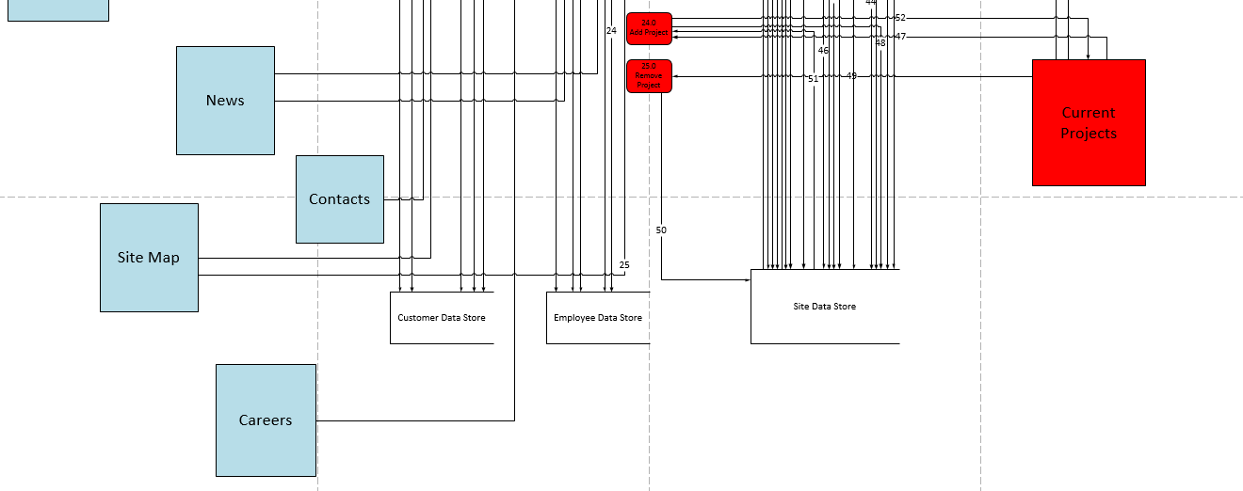
Level-0 Data Flow Diagram (4/4)

Slide 46
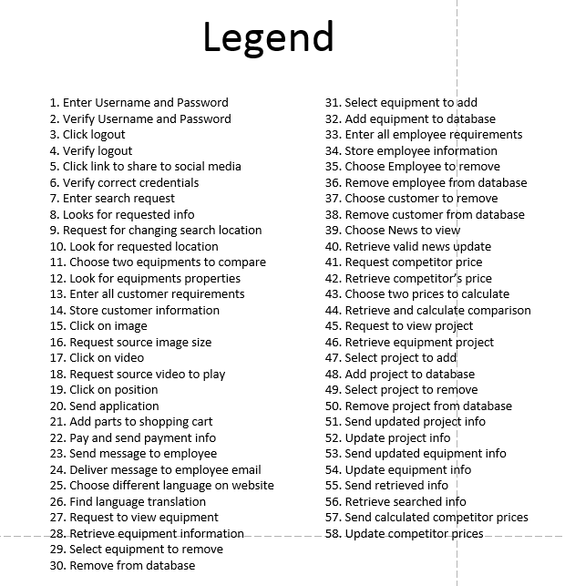
Level-0 Data Flow Diagram Legend

Slide 47
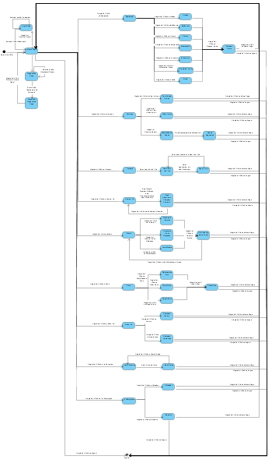
Full State Transition Diagram
Tool Used: Visual Paradigm

Slide 48
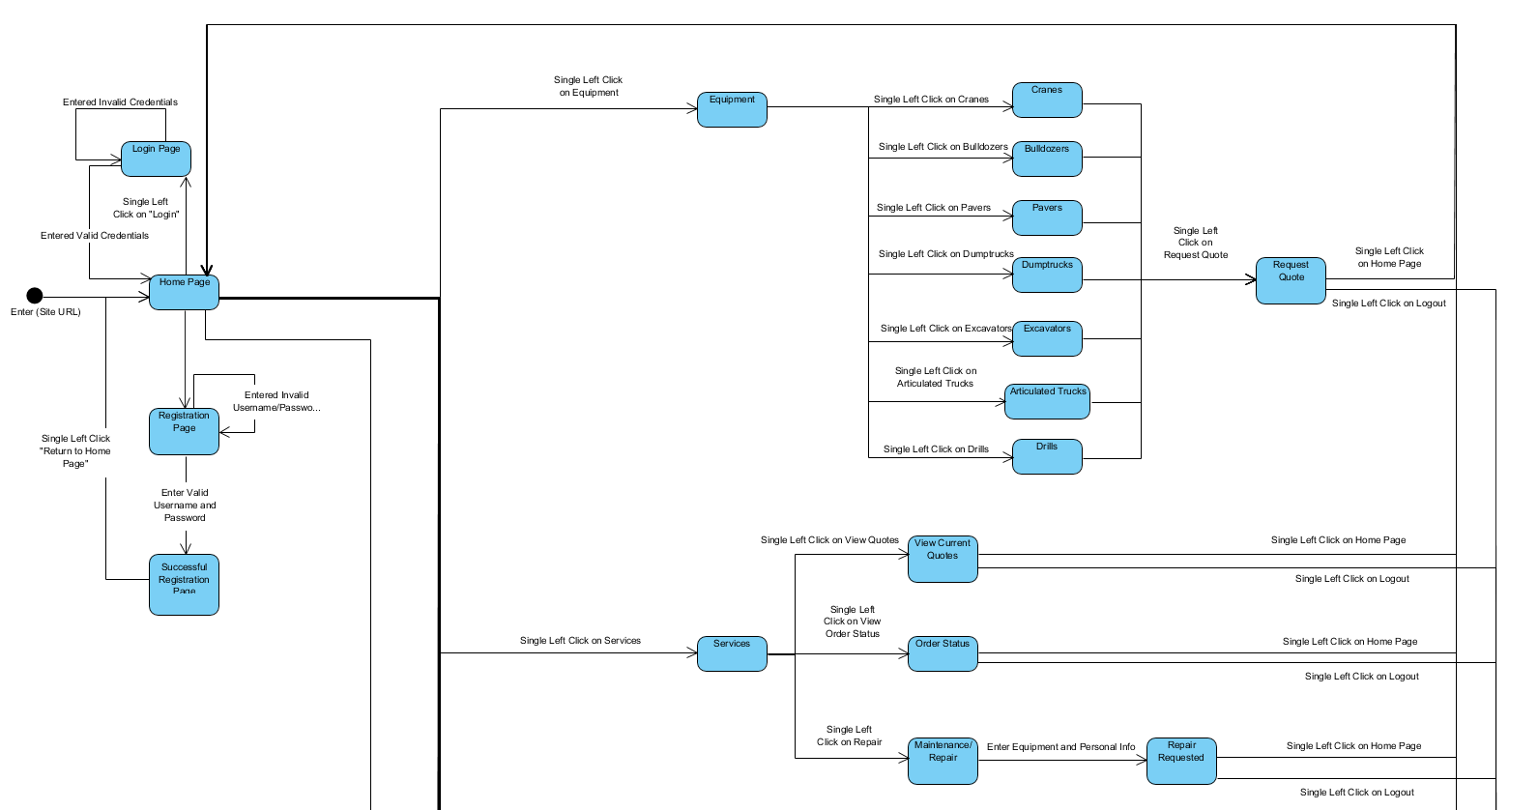
State Transition Diagram (1/3)

Slide 49
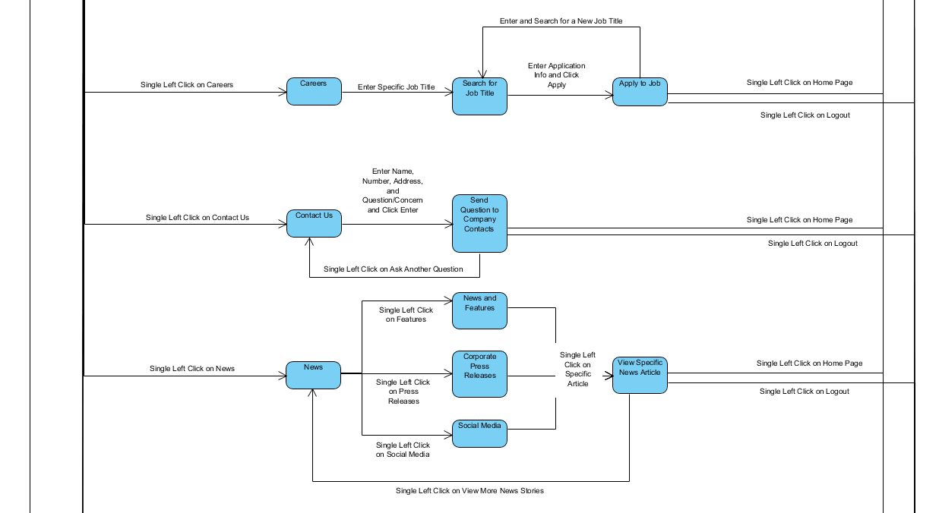
State Transition Diagram (2/3)

Slide 50
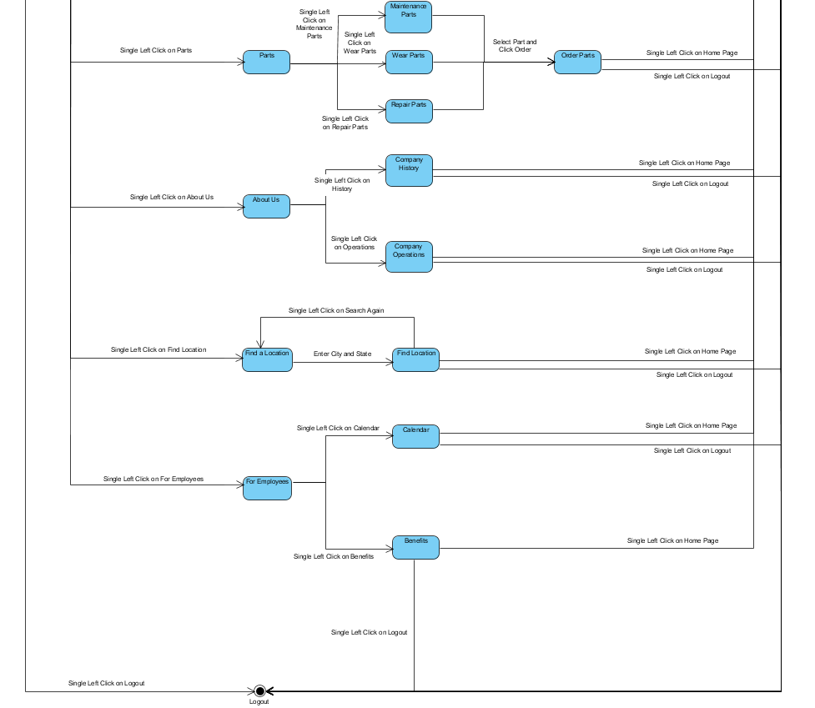
State Transition Diagram (3/3)

Slide 51
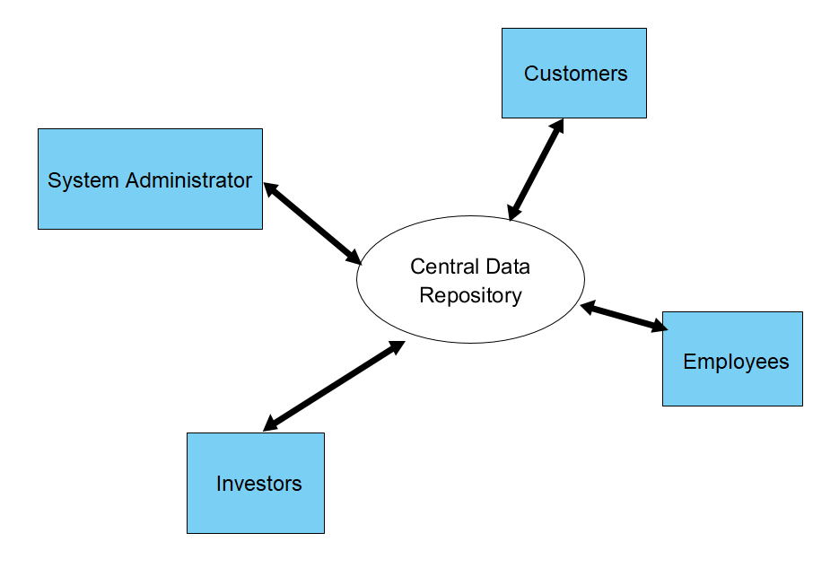
Software System Architectural Model
Data Centered
Integrability: new clients can be added and existing can be changed
Client software accesses a central repository
Tool Used: Visual Paradigm

Slide 52
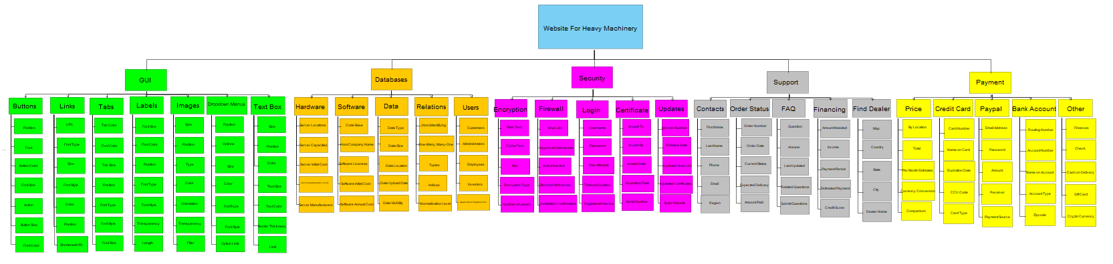
Hierarchical Design Model
Tool Used: Visual Paradigm

Slide 53
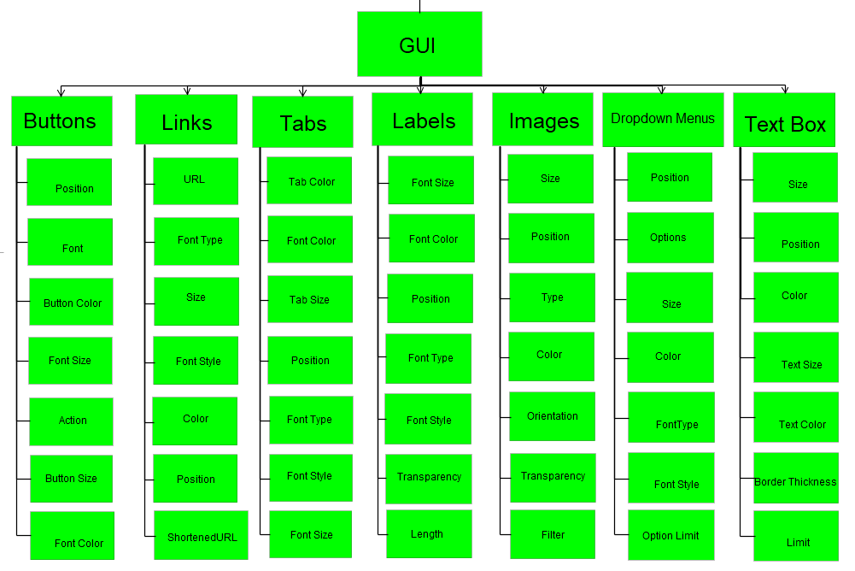
Hierarchical GUI Subsystem

Slide 54
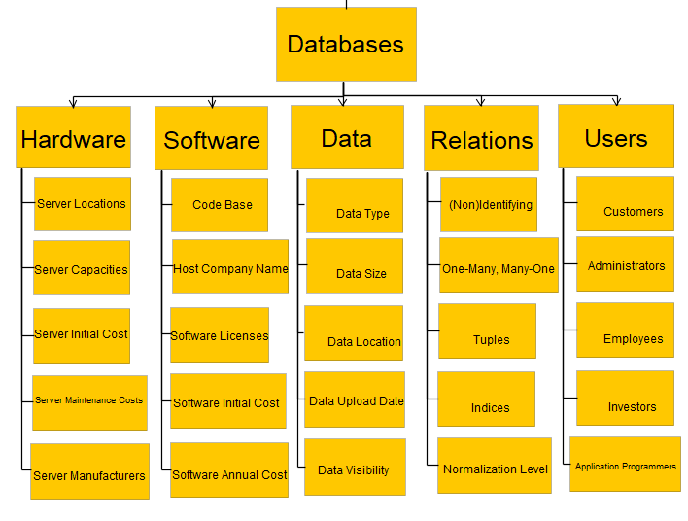
Hierarchical Database Subsystem

Slide 55
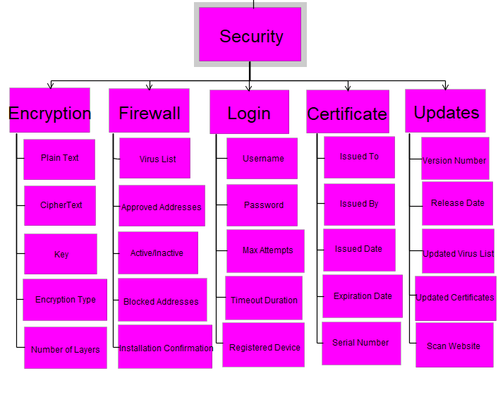
Hierarchical Security Subsystem

Slide 56
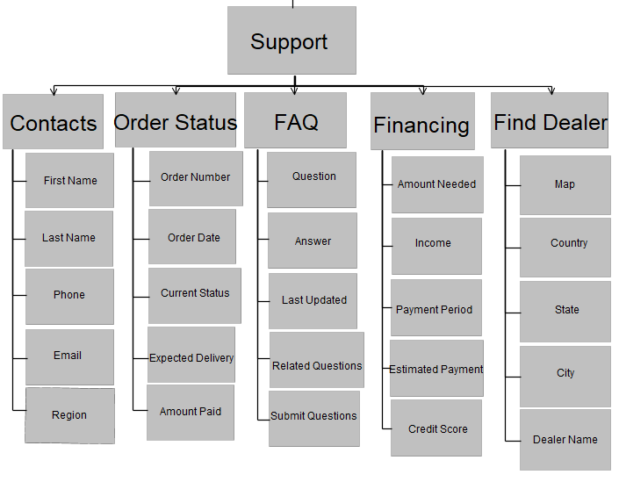
Hierarchical Support Subsystem

Slide 57
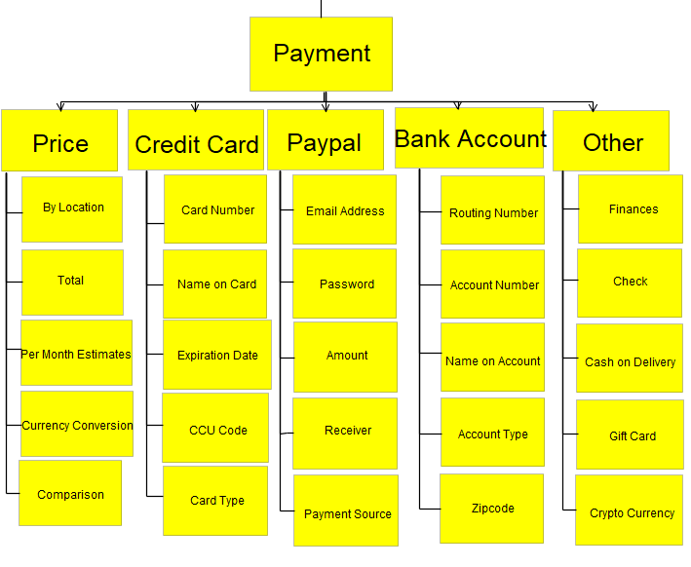
Hierarchical Payment Subsystem

Slide 58
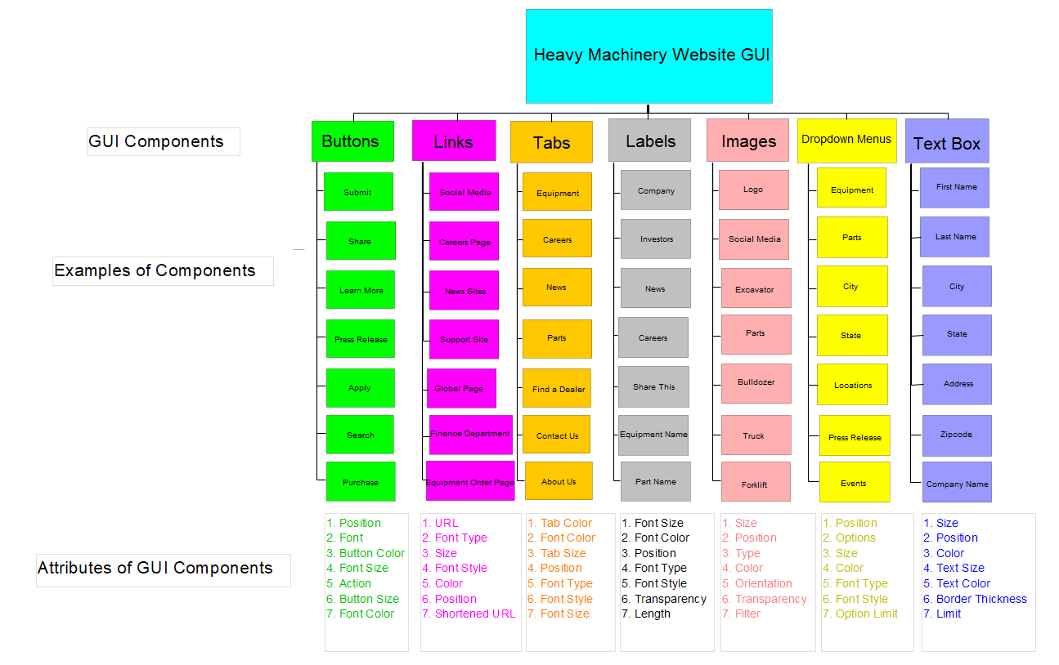
Hierarchical GUI Components View:
OPTIONAL PART
Tool Used: Visual Paradigm

Slide 59
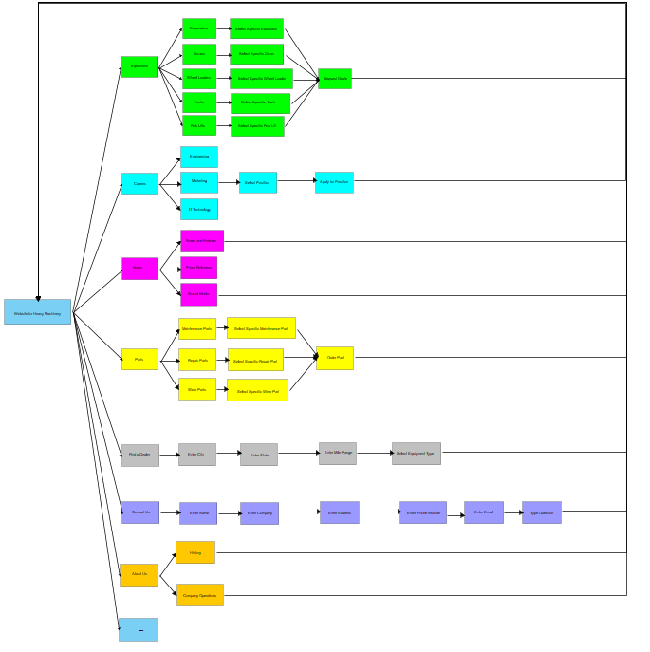
Hierarchical GUI Design Model
Tool Used: Visual Paradigm

Slide 60
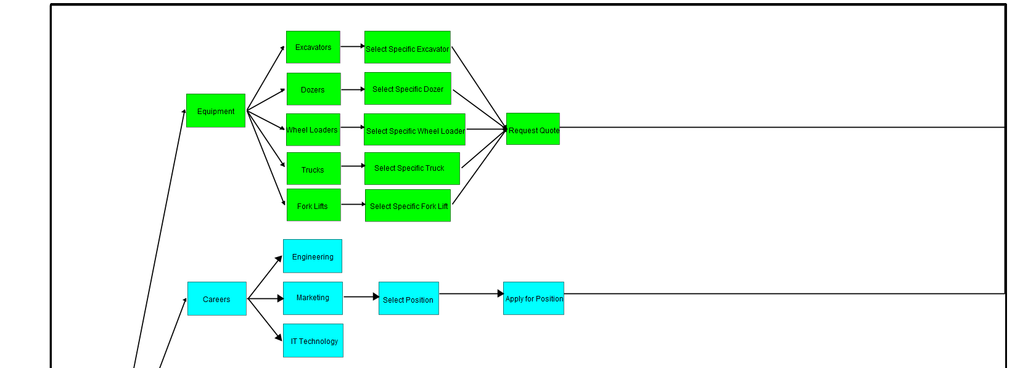
Hierarchical GUI Design Model (1/3)

Slide 61
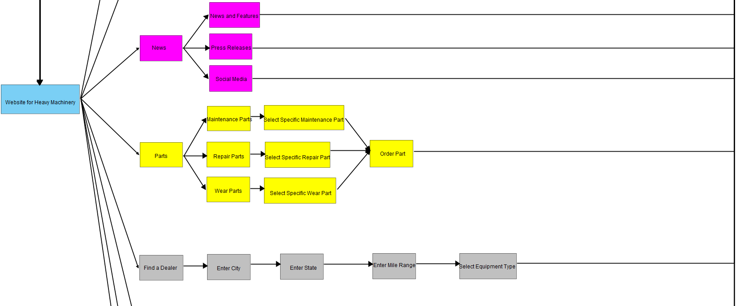
Hierarchical GUI Design Model (2/3)

Slide 62

Hierarchical GUI Design Model (3/3)

Slide 63

LOC-Based Estimation
Average Productivity: 620 LOC per month
Burdened Labor Rate: $8,000 per month
Cost per Line of Code: $13
Estimated Effort: 47 person-months
Estimated Project Cost: $377,000

Slide 64

FP-Based Estimation
Average Productivity: 6.5 FP per month
Burdened Labor Rate: $8,000, $1,230 per month
Estimated Effort: 48 person-months
Total Estimated Cost: $386,000

Slide 65
Resources
itpro.co.uk/611782/blade-networks-industry-ready-for-10gb-ethernet
https://constructionreviewonline.com/2017/04/topconstruction-equipment-manufacturers/
https://www.caterpillar.com/
https://www.komatsuamerica.com/
https://www.volvoce.com/united-states/en-us/
http://www.hitachi.us/
https://www.liebherr.com/en/usa/products/construction-machines/construction-machines.html
https://www.sanyglobal.com/
https://zoomlion-na.com/
https://www.terex.com/en
http://www.doosanequipment.com/dice/index.page?
https://www.deere.com/en/index.html

Slide 66
Thank you
Course: CS 390
Team #: 6
Team Members: Brad, Tyler

